Slide 1
Neonatal Sepsis
Dr. Ranmali Rodrigo (MBBS, DCH, MD, MRCPCH, IBCLC)
Lecturer Department of Paediatrics, University of Kelaniya
Senior Registrar in Neonatology
Internationally Board Certified Lactation Consultant
June 2018

Slide 2
Contents
Introduction
Classification
Risk factors
Clinical features
Diagnosis
Management
Prevention
Neonatal meningitis
Specific infections

Slide 3
Introduction
Neonates more vulnerable to infections (especially preterms)
Significant cause of neonatal deaths
Early diagnosis and treatment can save most babies
Definitions
Neonatal sepsis is a clinical syndrome characterised by signs and symptoms of infection with or without accompanying bacteremia in the first month of life.
Includes septicemia, meningitis, pneumonia, arthritis, osteomyelitis and urinary tract infections (UTIs)

Slide 4
Classification
Early onset sepsis (EOS)
Suspected sepsis within 48 – 72 hrs of birth
Source of pathogen: maternal genital tract or the delivery area.
Commonest organisms: Group B Streptococci, E.coli, Listeria monocytogenes
Respiratory distress due to congenital (intrauterine) pneumonia main feature
Late onset sepsis (LOS)
Features of sepsis appearing after 48 – 72 hrs from birth
Source of pathogens: community or hospital (nosocomial)
Commonest organisms: , Staphylococcus aureus, Coagulase Negative Staphylococcus, Escherichia coli, Pseudomonas
LOS commonly presents as septicaemia, pneumonia or meningitis

Slide 5
Risk factors – early onset
Early-onset sepsis
Maternal pyrexia >38°C or other evidence of infection
Prolonged rupture of membranes (ROM >18hrs)
Foul smelling liquor
Spontaneous preterm delivery (<37 weeks)
Very low birth weight (<1500g)
Prolonged or difficult delivery with instrumentation or ≥3 vaginal examinations in 24 hours or presence / removal of cervical suture
Maternal UTI in the third trimester

Slide 6
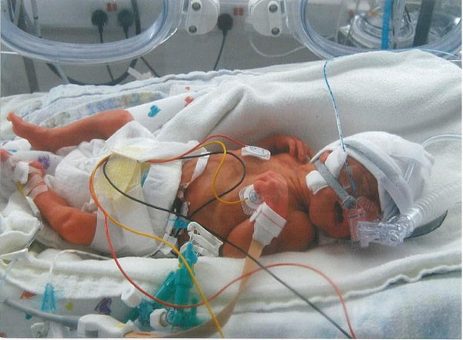
Risk factors - late onset
Late-onset sepsis
Very low birth weight, prematurity
Lack of breastfeeding
Delayed enteral feeding
Frequent handling/extensive resuscitation with or without invasive procedures
Disruption of skin integrity with needle pricks and use of intravenous fluids
Poor hygiene
Poor maintenance of asepsis in neonatal unit including improper hand washing techniques
Superficial infections (eg; skin and umbilical sepsis)
Previous or prolonged hospitalization

Slide 7
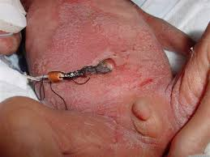
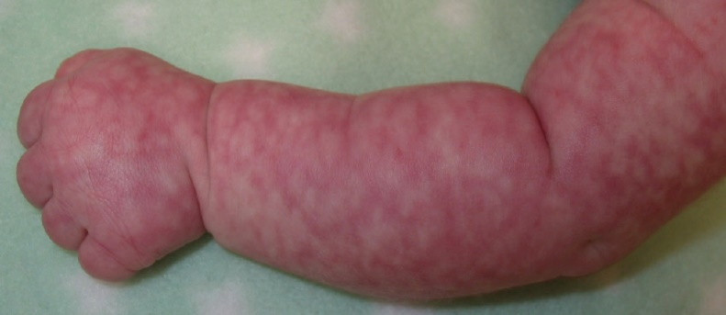
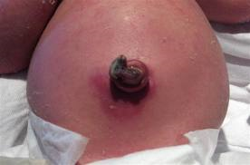
Clinical features
Highly variable; non specific
Mother or nurse may report that a baby is simply ‘not right’
Frequent early signs
Isolated tachypnoea
Feeding difficulties
Other signs
Temperature instability – hypothermia commoner than fever
Irritability
Skin – petechiae, omphalitis
Mottling
Jaundice - unexplained jaundice

Slide 8

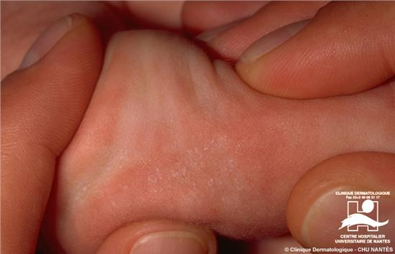
Clinical features
Tachycardia, low blood pressure
Vomiting, mild diarrhoea, abdominal distension
Apnoea, cyanosis, grunting and dyspnoea
High-pitched cry, bulging fontanelle and convulsions
Haemorrhagic diathesis
Sclerema
Hypotonia / lethargy

Slide 9
Diagnosis
Full sepsis screen :
Blood culture*
Full blood count*
CRP*
Urine Culture
CSF examination
CXR
*Partial Sepsis screen
Direct method of diagnosis: Isolation of microorganisms from blood, CSF, urine or pus is diagnostic.
In clinically suspected cases of sepsis, blood culture must be done before commencing antibiotics

Slide 10
Diagnosis
Indirect method of diagnosis:
Total WBC <5000/cu mm
Absolute neutrophil count < 1800 per cu mm
Neutropenia is more predictive of neonatal sepsis than neutrophilia
C-reactive protein (CRP): serial normal values helpful in exclusion

Slide 11
Management
Empirical antibiotics
Early onset sepsis
First line early onset
- Benzyl Penicillin (or Ampicillin) and Gentamicin
- add Cefotaxime or replace Gentamicin with Cefotaxime if meningitis is suspected
Second line early onset/ first line late onset
- Flucloxacillin/cloxacillin with gentamicin /Amikacin/ Cefotaxime
- Include Cefotaxime with any of the combinations in suspected meningitis
Third line
- Meropenum.+/- Vancomycin (if central line present and staph/MRSA is suspected
Duration of antibiotics
Based on clinical features & investigations (eg: blood culture positive & CSF normal 10days)

Slide 12
Neonatal meningitis
Clinical features
Early onset
Systemic features predominate
Late-onset
more likely to be associated with neurological symptoms
Majority : stupor and irritability
Seizures, bulging anterior fontanel, extensor posturing or opisthotonos, focal cerebral signs including gaze deviation and hemiparesis, cranial nerve palsies
Neck stiffness is the least common sign in neonatal meningitis
Septicaemic neonates may have meningitis without specific signs

Slide 13
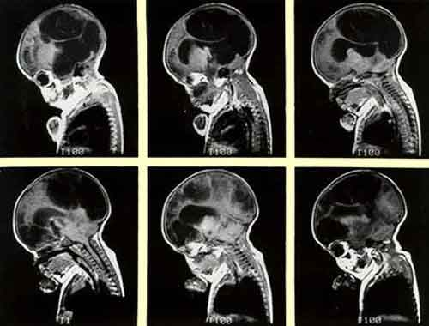
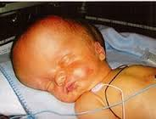
Neonatal meningitis
Devastating consequences
Subdural effusion, brain abscesses, ventriculitis
Cerebral oedema, haemorrhage, hydrocephalus
Epilepsy
Hearing and visual impairment
Cranial nerve palsies
Developmental delay
Cerebral palsy – spastic paresis
Microcephaly

Slide 14
Neonatal meningitis
Diagnosis: CSF analysis by lumbar puncture
Normal cerebrospinal fluid values in neonates
Courtesy: Roberton Textbook of Neonatology 5th Edition; 2013
Type of infant | White cell count (count/mm³) | Protein (g/l) | Glucose (mmol/l)
Preterm | 9 (0-30) | 1 (0.5-2.5) | 3 (1.5-5.5)
Term | 6 (0-21) | 0.6 (0.3-2.0) | 3 (1.5-5.5)

Slide 15
Neonatal meningitis
Acute management
Supportive care
Antibiotics
Empirical therapy
early onset disease- Penicillin/Ampicillin and Cefotaxime
late onset disease- Cefotaxime
Definitive therapy
GBS : Benzyl Penicillin for 14 days
Gram negative meningitis: Cefotaxime (or according to the culture report) for 21 days
Monitoring of head circumference
Cranial ultrasound
CT scans if indicated

Slide 16
Neonatal meningitis
Long term management
Monitoring of anthropometry including head circumference
Developmental assessment
Cognitive assessment
Hearing assessment
Visual assessment

Slide 17

Prevention
Hand hygiene
Breastfeeding ; early skin to skin contact with mother
Cord care at birth
Minimal handling of babies in NICU
Decreasing invasive interventions
Prophylactic antibiotics
Avoidance of broad spectrum antibiotics (unless specifically indicated)

Slide 18
Prevention
Indications for prophylactic antibiotics
Foul smelling liquor or malodorous baby
When ≥ 2 following risk factors are present
Maternal pyrexia >38°C or other evidence of infection
Prolonged rupture of membranes (ROM >18hrs)
Fetal distress (tachycardia, bradycardia, abnormal CTG), passage of meconium in-utero with no other explanation)
Spontaneous preterm delivery (<37 weeks)
Low Apgar <7 at 5 min
Prolonged or difficult delivery with instrumentation or ≥3 vaginal examinations or presence / removal of cervical suture
Maternal UTI in the third trimester
Unclean delivery and cord separation
Previous baby affected with GBS and mother’s recent GBS status unknown or not treated adequately

Slide 19
SPECIFIC INFECTIONS

Slide 20
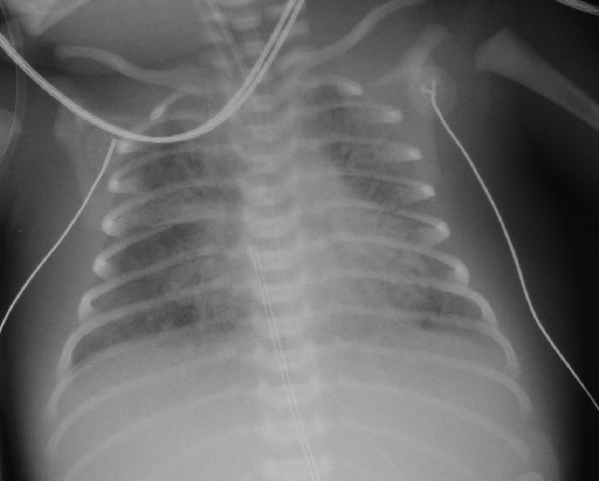
CASE HISTORY
33 week gestation baby
prolonged rupture of membranes for 20 hours
Minimal respiratory distress at birth
Worsened rapidly over next 2 hours

Slide 21
Group B Streptococcus
Incidence
10-20% women colonized in pregnancy
40-70% babies colonized
1% of these get disease
approximately 1/1000 live births
Features of Streptococcus agalactiae
serotypes Ia, Ib, and II-VIII cause EOS (2/3)
pneumonia and septicaemia
serotype III predominantly causes LOS (1/3)
bacteraemia and meningitis

Slide 22
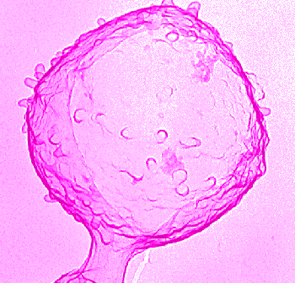
Group B Streptococcus
Diagnosis
Risk factors raise suspicion
surface swabs
blood and CSF cultures
Treatment
Benzylpenicillin
Outcome
mortality <10% overall
neurological sequelae in survivors of meningitis

Slide 23
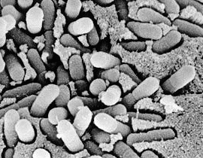
Escherichia coli
Early onset sepsis,
but continued risk up to 3 months old
Risk factors same as for GBS
PROM, chorioamnionitis, maternal fever
Bacteraemia, meningitis
Gentamicin for sepsis, cefotaxime if meningitis

Slide 24
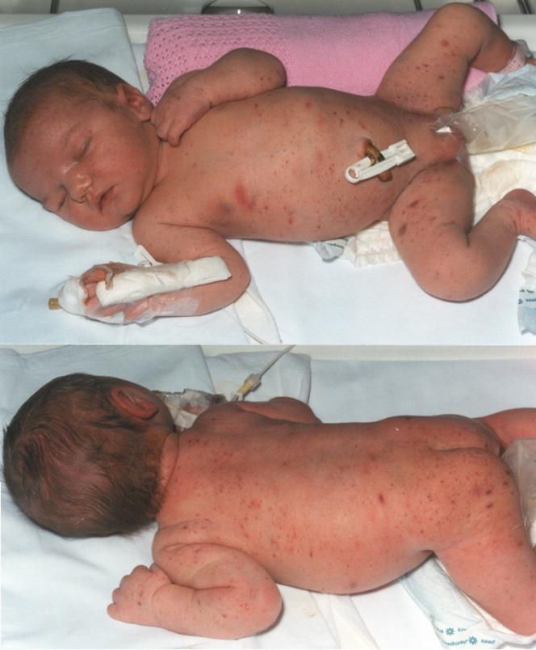
Case history
2 week old baby
uneventful pregnancy and delivery
presented with lethargy, poor feeding and high pitched cry.
Blood monocytosis
CSF = 700 neutrophils and Gram-positive rods.

Slide 25
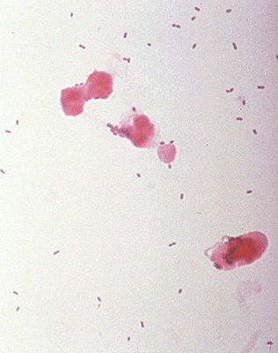
Listeriosis (Listeria monocytogenes) A Gram-positive intracellular bacillus
Acquisition and Incidence
Zoonosis
Food-borne spread
Fecal contamination of food, especially cook-chill, unpasteurized milk and soft cheese
Dietary advice - falling incidence
Transplacental spread - early-onset infection

Slide 26
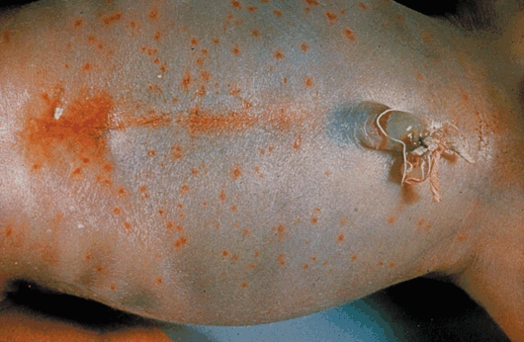
Listeriosis
Clinical features
early-onset
symptomatic maternal illness and bacteraemia (placenta becomes reservoir for bacteria), abortion
Granulomatosis infantiseptica
Microabscesses, pneumonia,meningitis
late-onset
at 1-4 weeks old, almost all with meningitis.
Often no maternal illness.

Slide 27
Listeriosis
Treatment
ampicillin + aminoglycoside
resistant to all cephalosporins
Outcome
mortality 50-100%
lower for late-onset meningitis
hydrocephalus, impaired vision/neurological sequelae.

Slide 28
Herpes simplex virus
Incidence: 2/100 000 live births.
HSV-2 accounts for 85%
Risk to baby
Seropositive: ~ 0.04% risk of transmission
shedding from reactivation during delivery: ~ 3% transmission
Maternal primary infection :~ 30-50% transmission
Notes:
Although can be a true congenital infection with fetal/in utero disease.

Slide 29
Herpes simplex virus
Features:
congenital (5%):
microcephaly or keratoconjunctivitis
neonatal (85%):
skin, eye or mouth (SEM) early (80% may progress)
generalized, involving liver, adrenals, lungs, brain, first week of life
CNS meningoencephalitis, presents ~ day 10
pneumonitis, presents days 3-7

Slide 30
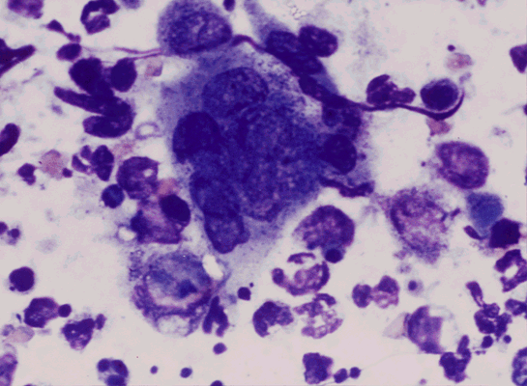
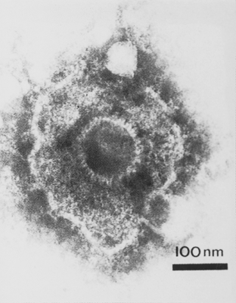
HSV diagnosis
1. EM, PCR, IF, culture of vesicular fluid
2. Microscopy of tissue scraping (multinucleate giant cells and intranuclear inclusions )
3. Serology

Slide 31
Herpes simplex virus
Treatment
prompt diagnosis and treatment is essential
acyclovir IV for 14-21 days
Outcome
even with early treatment of meningo-encephalitis, 85% major handicap

Slide 32
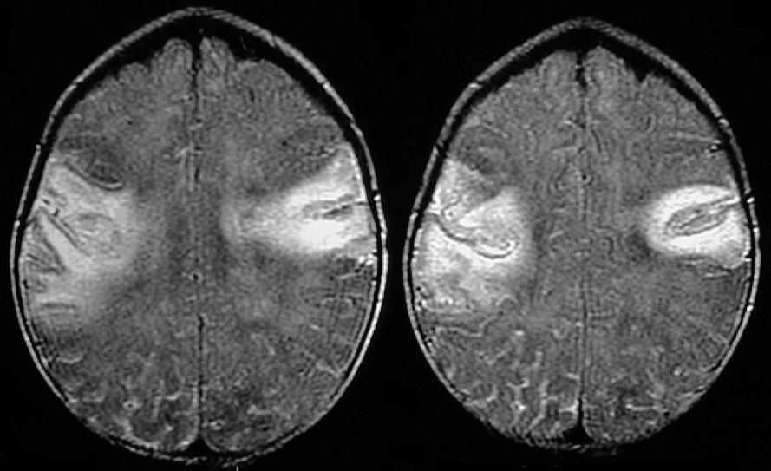
Bilateral temporoparietal lobe meningoencephalitis
Notes:
L temporal altered signal due to herpes encephalitis

Slide 33
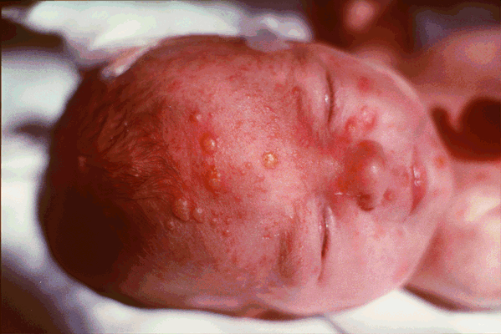
Case history
first day of life, term baby
mother developed rash two days before delivery
vesicular rash, tachypnoea

Slide 34
Varicella zoster (Herpes viridae)
Incidence
congenital varicella syndrome ~ 2% if maternal infection at 13-20 weeks
~ 0.4% if <13 weeks
~ 0% after 20 weeks
neonatal chickenpox : high risk if perinatal exposure
Acquisition
transplacental v. respiratory route

Slide 35
Varicella zoster
DIAGNOSIS
electron microscopy/PCR
PROPHYLAXIS / TREATMENT
Varicella zoster immunoglobulin prophylaxis and acyclovir treatment
OUTCOME
congenital - cicatricial skin lesions and hypoplasia of a limb; CNS; eyes
Neonatal - up to 30% mortality.

Slide 36
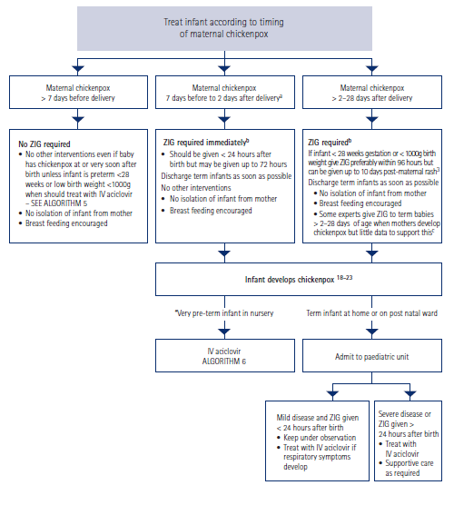

Slide 37
Any Questions?

Slide 38
Summary
Neonatal sepsis is a preventable cause of mortality and morbidity
Early diagnosis and management can avoid these
Clinical features non-specific
Prevention of neonatal sepsis is possible – hand washing vital

